Slide 1
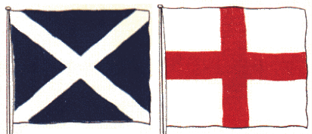
The Act OF UNION 1707
By: Naman Budhiraja

Slide 2
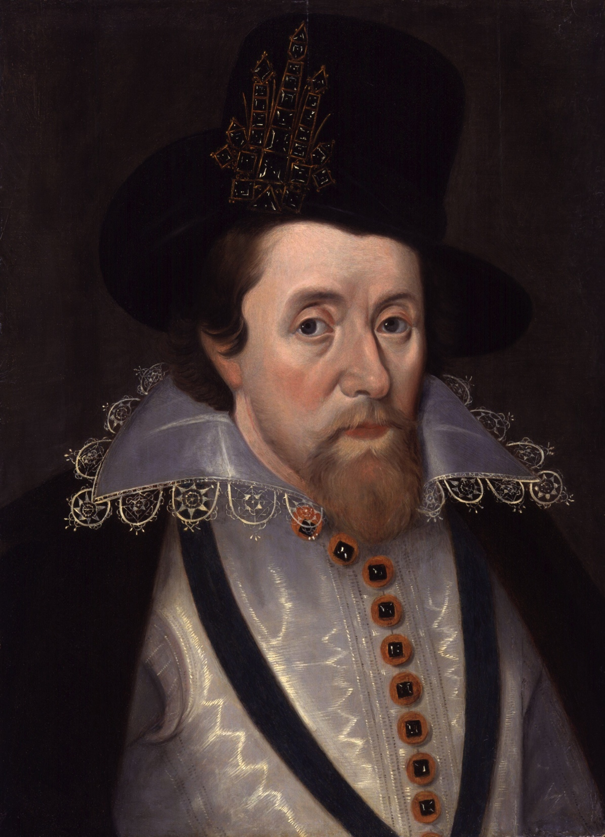
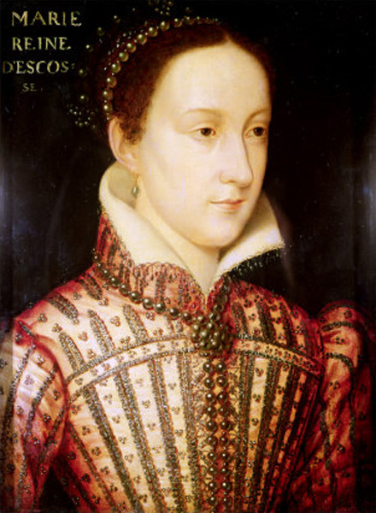
PRE-ACT Of Union
England and Scotland had always been independent states for several centuries before the Act of Union in 1707, despite multiple attempts by the British to take over Scotland in the 13th and 14th centuries. (See “Wars of Scottish Independence” http://www.educationscotland.gov.uk/higherscottishhistory/warsofindependence/)
In the 1560’s, Mary, Queen of Scots, promised a union between the two nations as a means of acquiring the throne.
The first time England and Scotland were ruled by the same ruler was when James VI of Scotland became the king of England, however the two remained separate states.
James VI
Mary, Queen of Scots

Slide 3
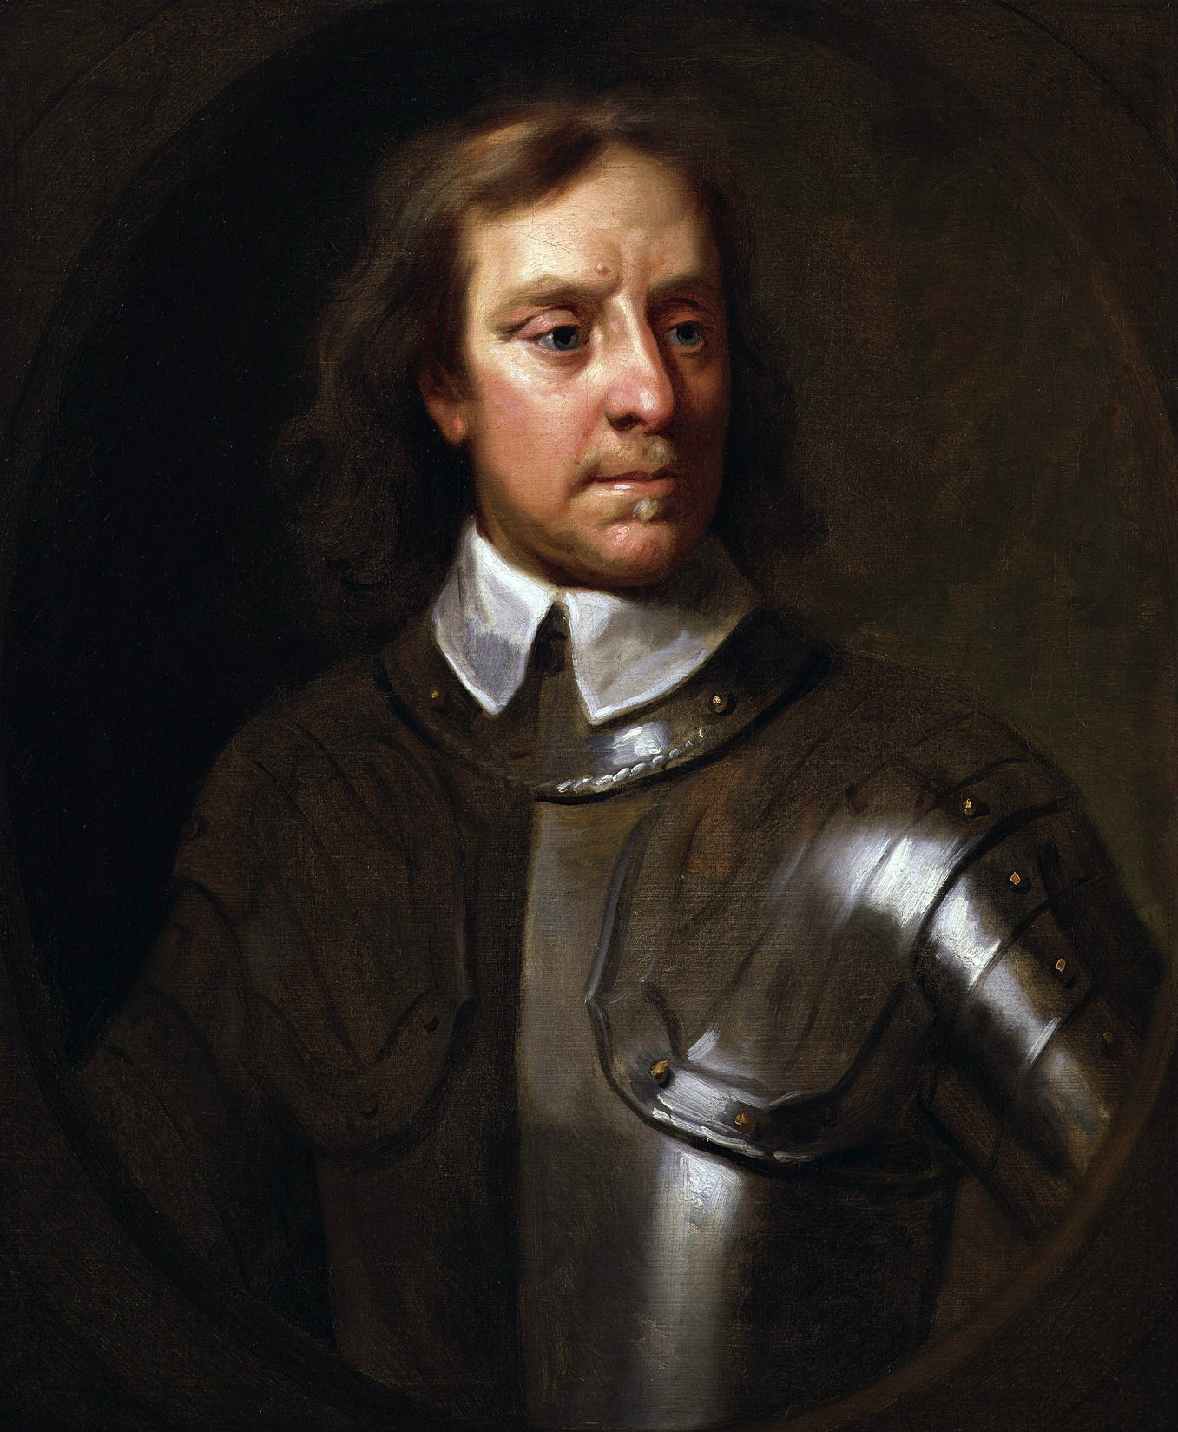
Pre-Act Of Union
James VI of Scotland, also James I of England, attempted to unite the kingdoms during his reign in 1603, but the English parliament feared that he would create an absolutist monarchy in England like the one that he ruled over in Scotland. The people also rejected this idea of unification and James abandoned the hope of uniting the nations.
After the English Civil War, Oliver Cromwell also tried to occupy Scotland and unify it and England, but the restoration of King Charles II caused the plan to be abandoned. (Seehttp://www.bbc.co.uk/history/british/civil_war_revolution/)
Oliver Cromwell

Slide 4
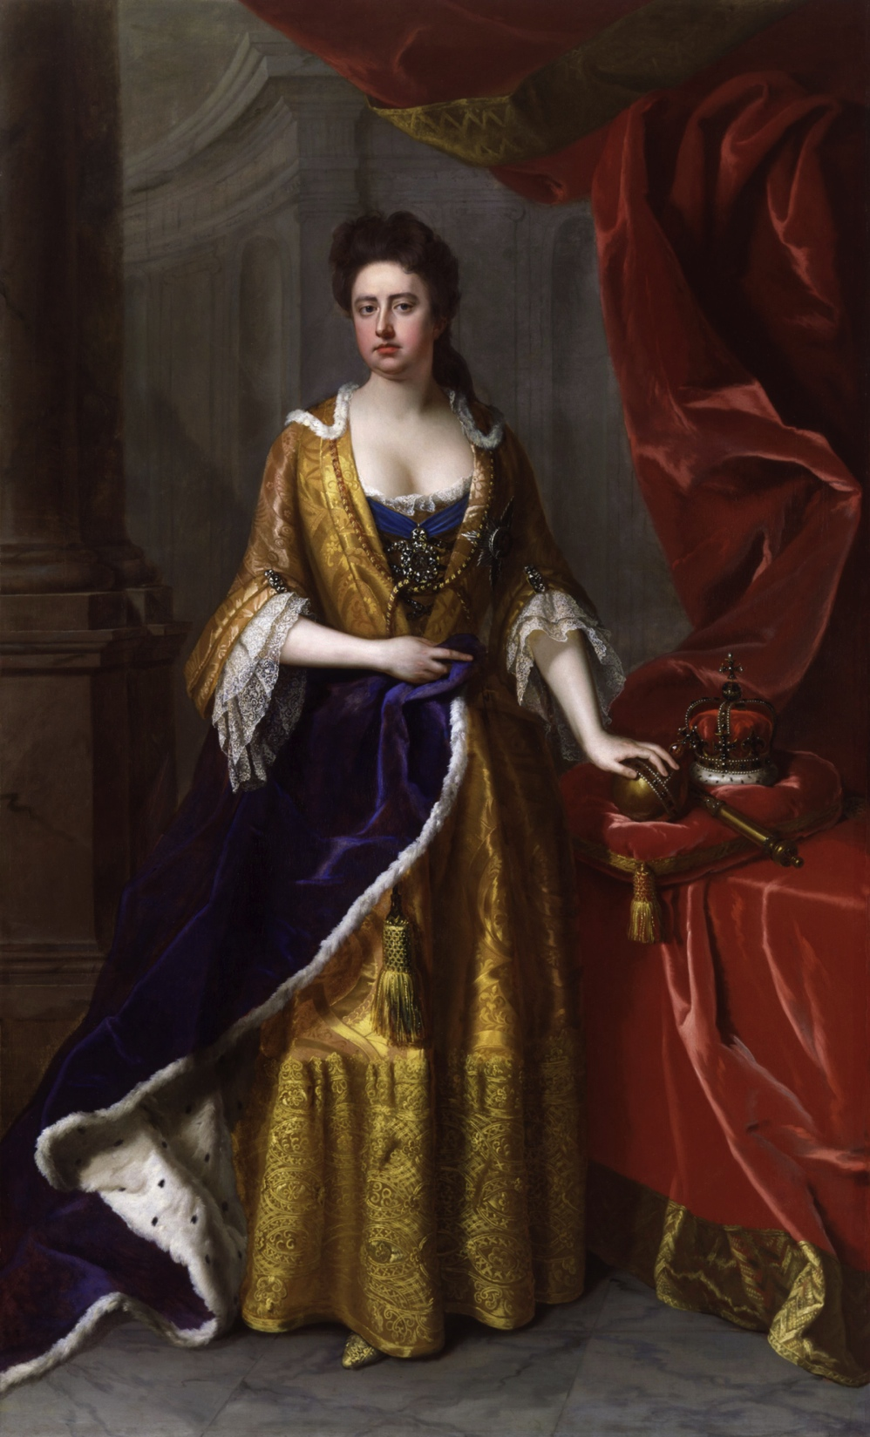
Process of Unification
Under Queen Anne, the parliaments of England and Scotland decided to negotiate for a union treaty in 1705. 31 commissioners were sent by each country to discuss union and most of the Scottish ones favored the union while only the English Tories opposed the union for the English.
The actual negotiations took place between April 16th, 1706 and July 22nd, 1706 at a theatre called the “Cockpit” in London.
England desired a guarantee that the Hanover dynasty would succeed Queen Anne to the throne and Scotland wanted an increased role in the trade and economics of the nations.
See manuscripts of the meetings http://www.british-history.ac.uk/report.aspx?compid=37670
Queen Anne

Slide 5
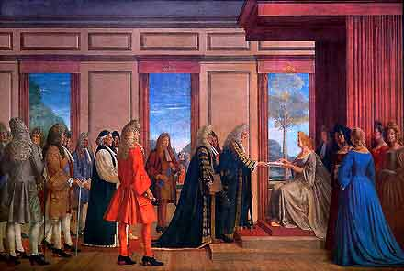
Process of unification
After negotiations ended between the two nations, the acts had to be unified by both nation’s parliaments.
In Scotland, the Duke of Queensberry was most responsible for the passing of the acts, which caused him to be largely disliked in Scotland, but loved in England. He was even received by the Queen when he came to London.

Slide 6
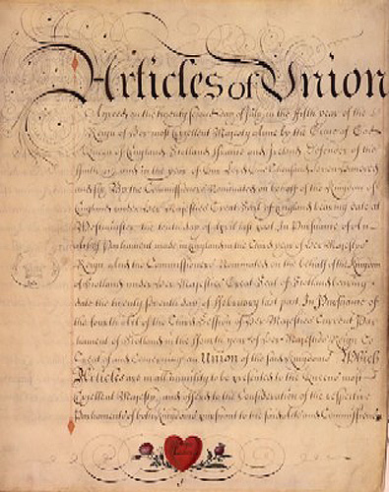
Act of Union 1707
The Act of Union 1707 read, “I That the two kingdoms of Scotland and England shall, upon the 1st day of May next ensuing the date hereof, and for ever after, be united into one kingdom by the name of Great Britain, and that the ensigns armorial of the said United Kingdom be such as Her Majesty shall appoint, and the crosses of St. Andrew and St. George be conjoined in such manner as Her Majesty shall think fit, and used in all flags, banners, standards and ensigns, both at sea and land.”
To read the entire Act of Union 1707 see http://www.cranntara.org.uk/treaty.htm

Slide 7
Scottish Response
The Scottish hoped that the union could save Scotland from the economic disaster they were in, but the Act of Union was largely unpopular with the people of Scotland.
William Forbes, a Scottish man, wrote, “England boldly tells you that youve no right to choose a successor to her present Majesty; nor the liberty to make good laws for the security of your most valuable interests.”
See more Scottish responses at http://www.nls.uk/collections/rare-books/collections/union-of-parliaments

Slide 8
English Response
The English response to the Act of Union was much more positive because they believed that it would be beneficial to them to have Scotland. They wanted to ensure that Scotland would not have a monarch different than the English one.
A passerby on a London road was quoted saying, “We all should promote a universal desire in this kingdom to become one in hearts and affections, as we are inseparably joyn'd in interest with our neighbour nation.”
See more English responses at http://www.bbc.co.uk/history/british/empire_seapower/acts_of_union_01.shtml

Slide 9
Effects
The Treaty of Union was mostly a means of saving Scotland from economic collapse, but of course England wanted benefits so they imposed taxes on trade, but it was calculated on taxed trade, not on trade conducted. The balance took no account of imported goods re-exported or reprocessed as manufactures for domestic consumption. An example of this is the Scottish networks exploited fiscal loopholes by investing £300,000 in brandies, wines, salt and whalebones which they intended to export to England tax free after May 1st. However, the East Indies remained the preserve of English commercial interests. Certainly the Scottish balance of trade appeared far from healthy, with imports hugely exceeding exports (BBC). See more about the effects http://www.bbc.co.uk/history/british/empire_seapower/acts_of_union_01.shtml

Slide 10
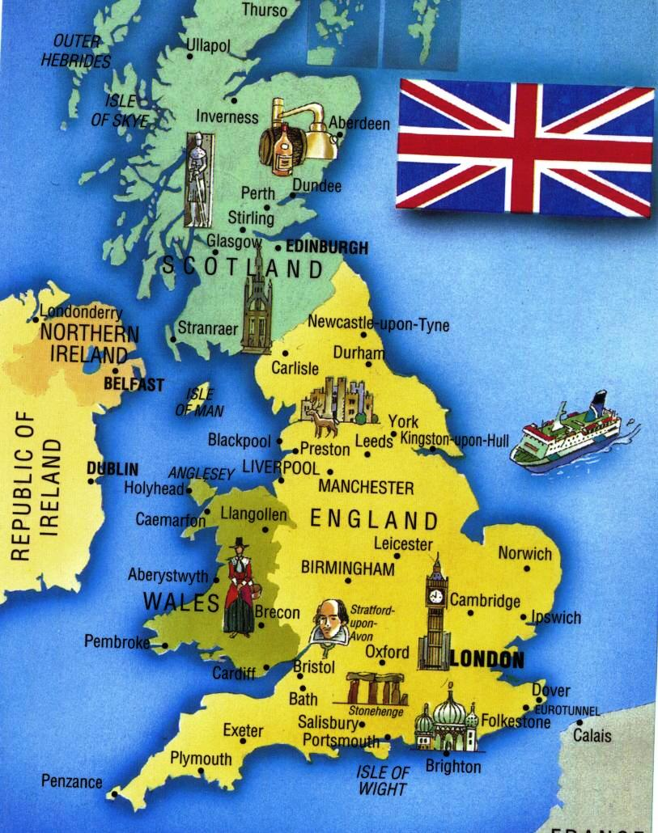
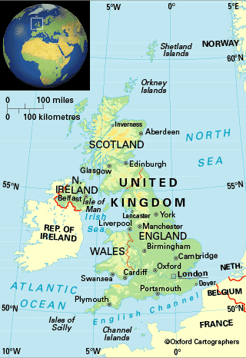
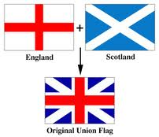
Boundary Changes
Before
After

Slide 11
Bibliography
"Documenting the Union of Parliaments." National Library of Scotland. National Library of Scotland, n.d. Web. 13 Mar. 2014. <http:// www.nls.uk/collections/rare-books/collections/union-of- parliaments>.
Lockhart, George. "The Road to Union." Scotland's Pages. Digital, n.d. Web. 13 Mar. 2014. <http://digital.nls.uk/scotlandspages/timeline/ 1707.html>.
McKim, Anne. "War of Words." Research Commons. Waikato, n.d. Web. 13 Mar. 2014. <http://researchcommons.waikato.ac.nz/bitstream/ handle/10289/3546/McKim%20War%20of%20words.pdf? sequence=1>.
"Queen Anne." The Second Parliament of Queen Anne. British History, n.d. Web. 13 Mar. 2014. <http://www.british-history.ac.uk/report.aspx? compid=37671>.
"The Treaty (or Act) of Union , 1707." The Treaty (or Act) of Union 1707. Cranntara, n.d. Web. 13 Mar. 2014. <http://www.cranntara.org.uk/ treaty.htm>.
"The Union of the Parliaments 1707." Union of the Parliaments. Education Scotland, n.d. Web. 12 Mar. 2014. <http:// www.educationscotland.gov.uk/scotlandshistory/ unioncrownsparliaments/unionofparliaments/>.

